Slide 1
Google Forms
Developing a Survey
Using

Slide 2
Google Forms: Background
Tool to develop online forms & surveys
Collaborate with others
Background in survey development
or programming not needed
Flexible
Free
Use via Google Docs

Slide 3
Other Platforms & Features
Other platforms include: SurveyMonkey, Zoomerang, Access, Qualtrics
Each with varying features, capabilities, costs, requisite technical backgrounds. Consider:
Ability to collaborate with others in survey design
Desire to see data in real-time
Flexibility to customize messages, logos
Advanced skip patterns, if/then statements
Need for easily understood data outputs
Cost
Google Forms perfectly fine for our use

Slide 4
Getting Started
3-steps
Develop survey
Collect survey data
Analyze data
Today we will:
Briefly discuss each step using different survey examples
Demo an evaluation survey
Develop your teach-back evaluation

Slide 5
How to Get Started
Open your Google Docs folder
Select Forms
Select Go to Forms
By default, you will see a blank survey
As you develop a survey, it will auto-save

Slide 6
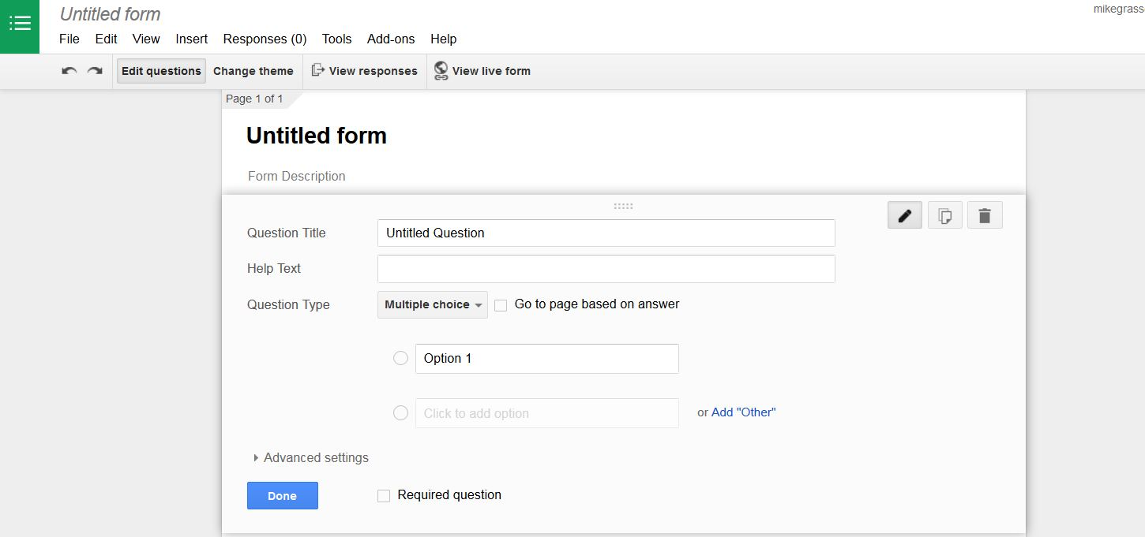
Develop survey (Slide 1 of 4) Navigating the Menu Bar & Form
Familiarize yourself with the horizontal menu bar
Explore the different features to suit your specific needs (ie: layout, font type, progress bar, avoiding duplicate submissions)

Slide 7
Develop survey (Slide 2 of 4) Question/Response Types
Allocate time to developing strong questions & response sets
Consider the question: “What is your favorite animal?”
What response type best answers the question?
-Multiple choice (select only one) OR
-Checkboxes (select all that apply)
Depending on your question, other types of responses may be more appropriate:
-Text type, paragraph type, scale type, grid, time & date

Slide 8
Surprise Slide What’s wrong with the question & response options?
Q4. What is the HIV positivity rate?
0-5%
5-10%
10-15%
15-100%
>100%

Slide 9
Surprise Slide - Answers What’s wrong with the question & response options?
Q4. What is the HIV positivity rate?
0-5%
5-10%
10-15%
15-100%
>100%
Answers:
Question may be vague (ie: who, when, where)
Overlapping responses; positivity rate >100% not possible

Slide 10
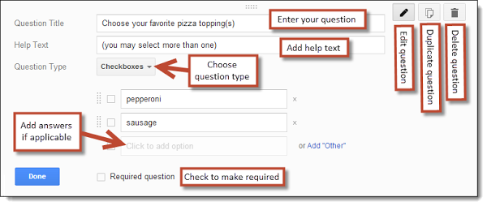
Develop survey (3 of 4)
Your first survey question
Source: Eric Curts “Using Google Forms”
http://tinyurl.com/kzpd3bs

Slide 11
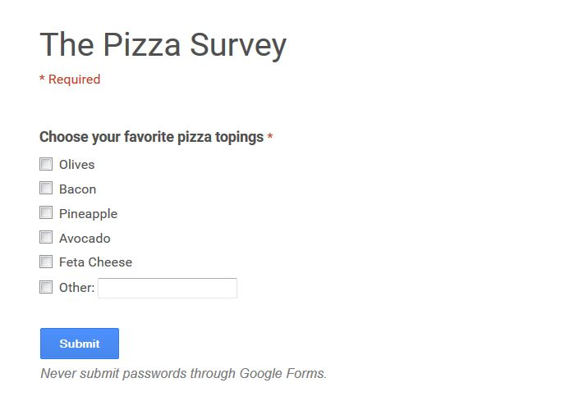
Develop survey (4 of 4) Viewing the Live Form

Slide 12
Collect survey data
Two steps:
In the Responses drop down menu, ensure “accepting responses” is activated
Click the “send form” button to generate a unique URL for people to click-thru to the survey

Slide 13
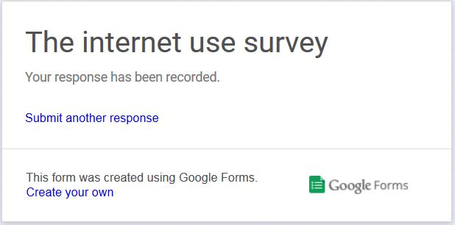
End of Survey
Considerations:
Customized end-of-survey message
Managing duplicate & partially completed
Publishing results real-time
Ending survey (stop accepting submissions)

Slide 14
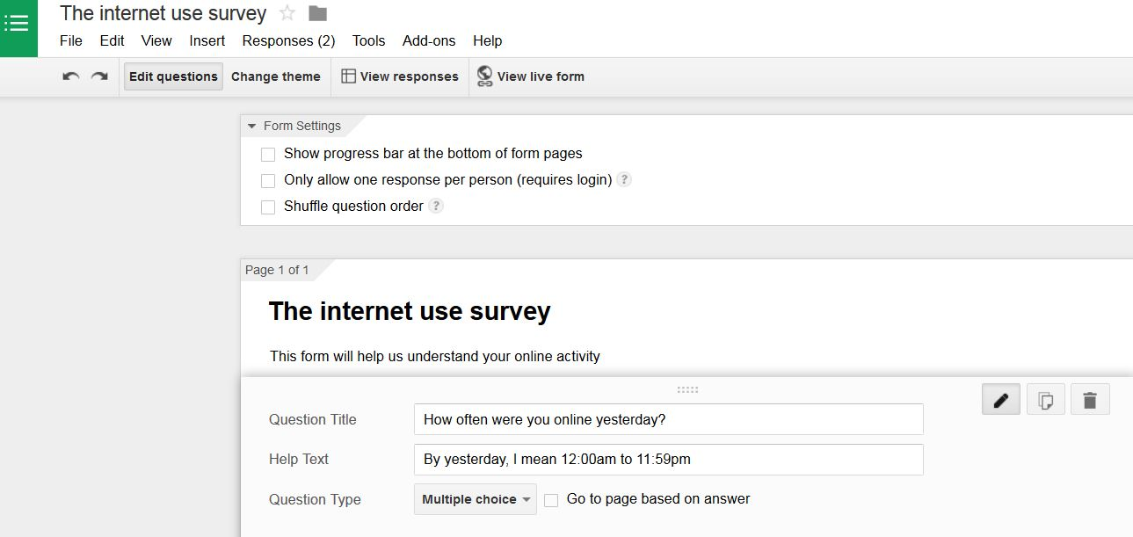
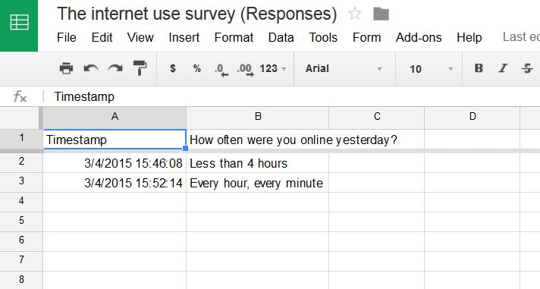
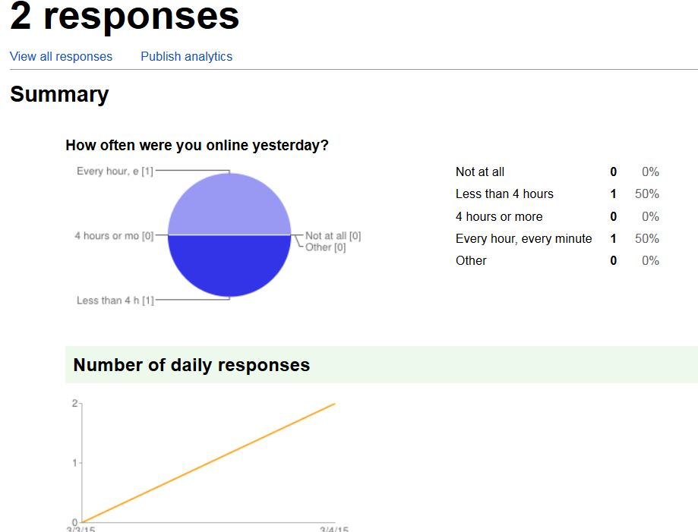
Survey Responses

Slide 15
More Advanced Functions
Adding collaborators
Add images & videos
Utilization of section and page breaks
Shuffling the question order
Progress Bar
Embed URL
Shortened URL
Standard: https://docs.google.com/forms/d/1O_2KFRSy1BjSsyvzzBIGiEojVEwCbjO2_33Puw68ge0/viewform?usp=send_form
VS
Shortened: http://goo.gl/forms/3ujbPFnoSQ

Slide 16
Demo an Evaluation Survey

Slide 17
Lightning Talk
Articulate what you’ve learned this week in a quick, insightful, and clear presentation

Slide 18
Lightning Talk
Format:
--What & Why: Overview of Google Fusion Tables and why we use it
--How: Demonstration of use
--Findings: Show results, interpretations and conclusion(s) from data (>/= 1 output)
Time
15 minutes to speak & demonstrate what you learned this week
5 minutes for Q&A
Present twice, receive twice

Slide 19
Develop your own evaluation
Given the suggested Talk components:
--What & Why: Overview of Google Fusion Tables and why we use it
--How: Demonstration of use
--Findings: Show results, interpretations and conclusion(s) from data (>/= 1 output)
Develop your evaluation in Google Forms
--Create your own evaluation which your (2) colleagues will complete
--The topic is…. “evaluation of teach-back”
--At least six questions; use at least three different question types, encompassing the Talk components
--Include your (The presenter) name in the form description
--Meaningful feedback

