Slide 1
HIV Data Triangulation and Use
Johannesburg, South Africa
17-20 March 2015

Slide 2
Welcome
Please introduce yourself…
Name
Affiliation
Role
Say one expectation you have for this workshop

Slide 3
Data Triangulation and Use in South Africa
Jan 2013: 3 day workshop, 11 participants
CDC/USAID
July/Aug 2013: 2.5 day workshop, 18 participants
2 PDOH representatives each from: Eastern Cape, Gauteng, KZN, Limpopo, Mpumalanga, Western Cape,
NDOH, ANOVA Health Institute, USAID, ACTSASA
Nov 2014: 3 day workshop, 41 participants
Pilot Data Use and Strategic Planning model for district and facility level audience: Implementing Partner (IP, n=16) and DOH staff (n=25)
17-20 March 2015
District Support Partner Training of Trainers workshop
2015-2016
DSPs roll-out data triangulation model to respective districts in South Africa

Slide 4
Workshop goal & objectives
Goal: To achieve the goals of the National Strategic Plan 2012-2016 by assessing and mapping HIV program coverage and impact at province, district, sub-district and municipality levels in order to improve HIV programs through evidence based strategic planning.
Objectives
To identify HIV linkage to care strengths and gaps
To encourage the use of data in service and resource planning at the facility, sub-district, district and provincial levels.
To improve the quality of reporting especially at the facility level
To build capacity in facilitating this training to other audiences

Slide 5
Agenda
Day 1:
Introduction to data triangulation, Fusion Tables and fact sheets
Day 2:
Use Fusion Tables to answer specific objectives
Identify strengths and gaps of HCT data and program within district based on data outputs and NSP
Day 3:
Develop evidence –based, actionable recommendations for the district based on HCT strengths and gaps
Determine next steps and action items for HCT priorities in the province

Slide 6
Day 1
Introduction to HIV in South Africa
Introduction to Data Triangulation and Use
Lecture guided work: Google Fusion Tables

Slide 7
Day 1
Introduction to HIV in Mpumalanga
Introduction to Data Triangulation and Use
Lecture guided work: Google Fusion Tables

Slide 8
Data Use Website
Resources and workshop materials stored here:
http://datause.ucsf.edu
Please complete the start of workshop survey

Slide 9
Why Do We Spend So Much Time and Energy Collecting All This Data ?!
Strengthen M&E programs
Improve program planning and resource allocation
Gain efficiency and effectiveness
Use evidence for decision making
Strengthen capacity of staff
Improve data quality

Slide 10
Data Is At The Center of M&E
DATA
Improve coverage, reach, intensity of services
Improve quality of data
Priority setting and resource allocation
Accountability
But…..only if we review, discuss, interpret, and use it regularly!
Notes:
Which steps you focus on more depends on your objective

Slide 11
Why good data is important
National level
Informs policy
Assists in planning and assessing various interventions to make strategic decisions about the improvement of those interventions
Works towards meeting the overall national goal of reducing the burden of poor health
Provides evidence towards meeting targets
Provides the basis for M&E
Region/district level
Informs acquisition and distribution of resources
Provides evidence for construction and/or expansion of facilities
Explains human resource capabilities and challenges
Assists with more precise budgeting
Assists council authorities in planning interventions and monitoring those activities
Demonstrates trends in calculated indicators used to estimate future changes
Demonstrates trends in calculated indicators used to estimate future changes
Facility Level
Serves as basis for planning and developing Interventions
Allows providers to identify patients/clients in need of services and/or referrals
Improves efficiency through administrative organization
Inventories resources and determines which supplies and medicines are available and which need to be ordered when
Monitors and evaluates quality of care

Slide 12
HIV Data Triangulation and Use Process
A process for incorporating into program plans
Where are we now?
Examine data on the current epidemiology, program coverage and locations and costs
Where do we want to go?
Identify or refine program goals
How do we get there?
Establish a timeline and action steps for achieving program goals

Slide 13
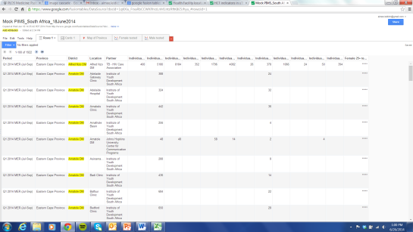
HIV Data Triangulation and Use Process
Data Use Tool
Surveillance
Questions of interest
Available data
Program
data
Surveys
Program improvement
Identify strengths and gaps

Slide 14
By the end of this workshop you will:
Create your own website showing the results, interpretations and conclusions drawn from your data

Slide 15
Day 1
Introduction to HIV in Mpumalanga
Introduction to Data Triangulation and Use
Lecture guided work: Google Fusion Tables

Slide 16
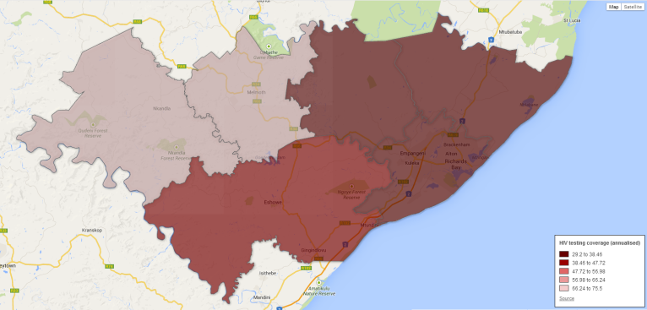
Fusion Tables

Slide 17
1. Getting started with Google Fusion Tables
1.1. Setup
1.2. Data Inputs
1.3. Importing data into Google Fusion Tables
1.4. Calculating Formulas
2. Visualizing data
2.1. Cards
2.2. Charts
2.3. Maps
2.3.1. Point maps
2.3.2. Polygon maps
3. Final steps
3.1. Downloading a dataset
3.2. Filtering data
3.3. Editing data
3.4. Creating additional outputs
3.5. Accessing saved FusionTables
3.6. Sharing Google FusionTables and Charts

Slide 18
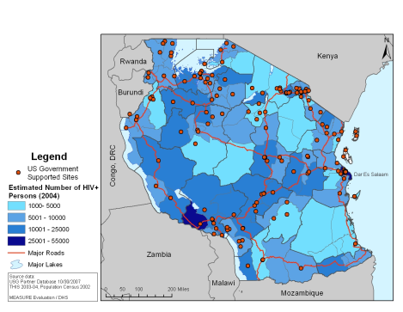
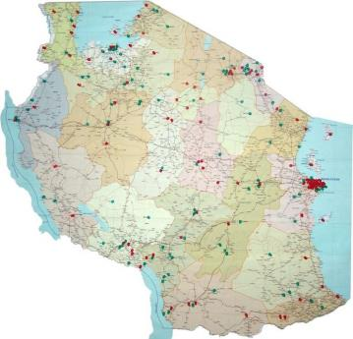
Mapping data
National AIDS Control Program, Republic of Tanzania
http://www.nacptz.org/
Notes:
Tanzania has moved from this… [a paper map] pinned on the wall pins identifying USG supported sites. Right slide looking at first layer represents estimated HIV+ persons we’ve added a top layer to show USG sites along major roads. Could easily replace HIV+ estimates with HIV incidence numbers or newly diagnosed HIV+ ppl who entered into care.
Map credit: Nathan Heard

Slide 19
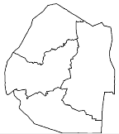
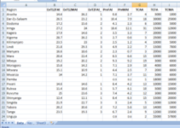
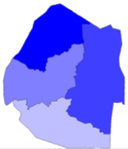
Mapping process
Geographic coordinate data
HIV indicator database aggregated by geographic level
Produce a shape file or KMLdata file
Mapping software links geographic data and coordinates
Map is produced
Notes:
Coordinates such as lat/longitudue, elevation produce a shapefile. 2. HIV indicator data in a DB based on diff geographic levels. 3. Mapping software links the two together 4. GIS software (epi info, arc gis) displays a map for visualization

Slide 20
Data Key and Indicator List - Recommendation of indicators and formulas to use

Slide 21
Day 1: Small group work
Please break up into groups of 3-4 people. Use Google Fusion Tables to explore your data and answer Questions 1 and 2 on the Data Key and Indicator List.

Slide 22
Day 2
Results, interpretation and conclusions
Create your own website and present results, interpretation and conclusion to identify strengths and gaps of data and program using Google Fusion Tables

Slide 23
Day 2
Results, interpretation and conclusions
Create your own website and present results, interpretation and conclusion to identify strengths and gaps of data and program using Google Fusion Tables

Slide 24
BASICS OF Visually presenting data

Slide 25
Key Definitions
Results: Simple description/observations of your results (who, what, where, when, magnitude, trend).
Interpretation: Explanation of why your results may have occurred.
Conclusion: the key message of your results, implications and the “action-plan” that you recommend based on your results.
The “Take Away”
Result
Interpretation
Conclusion
Nine elephants damaged storefronts on Market St in Joburg in 2010, one elephant damaged a store in 2013.
The number of elephants on in Pretoria has decreased since 2010 because an elephant lover has started laying a trail of peanuts to Kruger Natl Park
Citizens should be sensitized to encourage elephants to play in Kruger Natl Park instead of in Pretoria

Slide 26
RESULTS

Slide 27
Presenting Data In Tables
Tables may be the only presentation format needed when the data are few, relationships are straightforward and when display of exact values is important.
Table X. PEPFAR annual progress reporting, PMTCT indicators, FY12-13, Namibia
Indicator | Estimate
Number of pregnant women that are tested or know their HIV status at ANC and L&D | 62,142
Number of pregnant women with known positive status at entry to ANC or L&D | 7,546
Number of pregnant women newly tested positive | 4,251
Source: PEPFAR Annual Progress Report, Namibia 2013

Slide 28
Bar Charts Are Useful to Show Simple Comparisons, Esp. Differences in Quantity.

Slide 29
Line Charts Are Good for Showing Change Over Time (Trend)

Slide 30
Bar and Line Charts Can Be Used Together to Show Trends Of Several Related Indicators

Slide 31
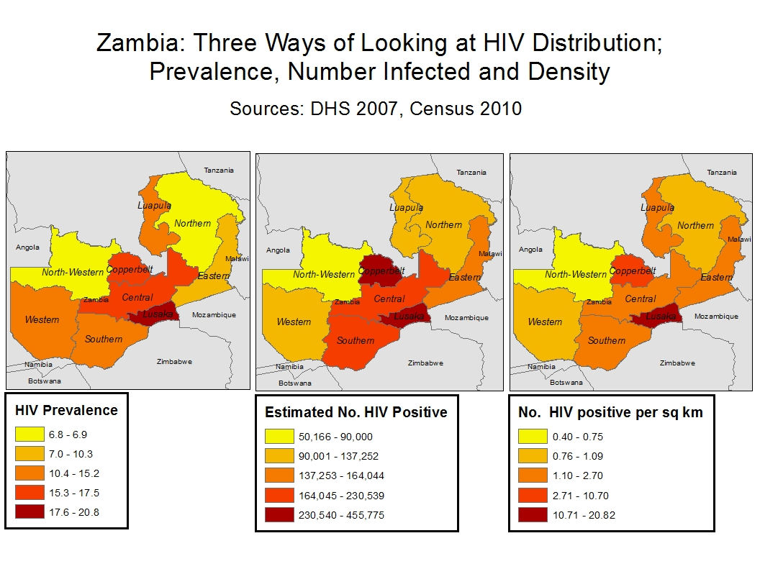
Maps show geographic relationships
Est. no. HIV + per sq km

Slide 32
Figure title
Be sure to include:
What (the indicator)
HIV prevalence
% circumcised
% alive on ART
Who
pregnant women age 15-49
adults males age 15-49
pediatric ART patients
Where
in Namibia
in Ohangwena region
at Engela Hospital Clinic
When
in 2012
from 2008 to 2012

Slide 33
What ?
Where ?
Who ?
When ?
Source: Namibia MOHSS (2012) Annual Implementation Progress Report for the National Strategic Framework (NSF) 2011/12.

Slide 34
Presenting Data Tips (2)
All relevant information needed to interpret the table, figure, or map should be included so that the reader can understand without reference to text (i.e. in a report)
Clearly label your X and Y axes, format consistently (font, font size, style, position)
Use data series legends /labels
Make the scale appropriate for the findings you want to convey.
Reference the source of your data

Slide 35
Scale spans to 100% to display complete picture
Clear chart title
Y-axis label
X-axis label
X-axis label
Data source reference
Series legend
Source: Namibia MOHSS (2012) Annual Implementation Progress Report for the National Strategic Framework (NSF) 2011/12.

Slide 36
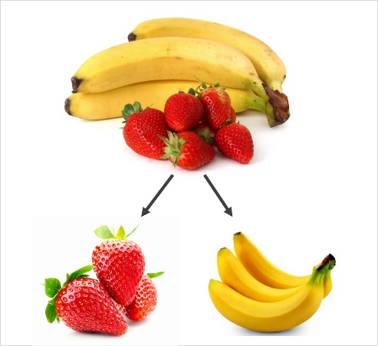
Stratification of Data
What is stratification?
Dividing into subgroups
What are common levels of data stratification?
Year, age, sex, geographic region, facility
Why do we stratify?
Let’s look at stratification within the indicator:
% of patients alive on ART 12 months after initiation

Slide 37
What Do You Think About This Figure?

Slide 38
We Can Stratify By Facilities Within Geographic Areas

Slide 39
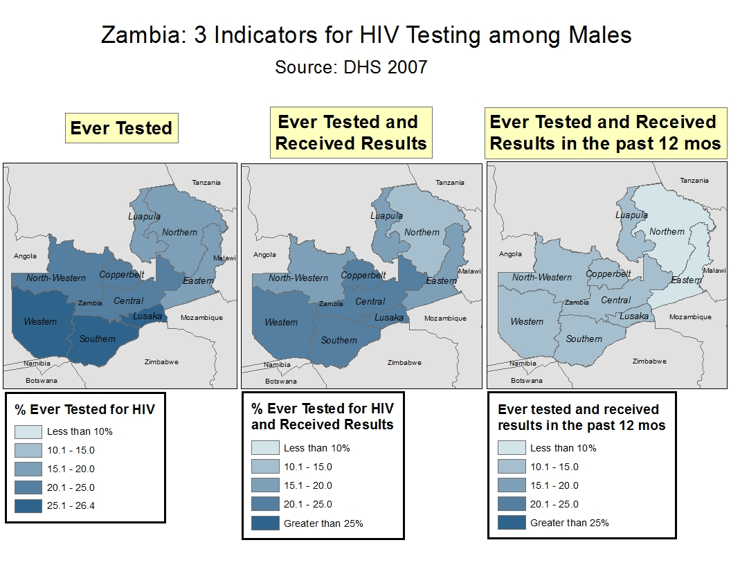
Females
We Can Stratify By Sex and Geography …
Three indicators for HIV testing by sex and province. Zambia. 2007
Males
Source: DHS 2007

Slide 40
INTERPRETATION

Slide 41
Magnitude and Trend (1)
Magnitude :
the amount of coverage
The size of the difference between sub-groups or time points
Trend:
the direction of change over time (i.e. increasing, decreasing, or remaining stable)

Slide 42
Magnitude and Trend Statements (2)
Fig. 23. HIV prevalence among pregnant women receiving antenatal care at public facilities in Country X, 1992-2012
“ From 1992 to 2002, HIV prevalence among pregnant women increased (trend) from 4.2% to 22% (magnitude).
After peaking at 22% in 2002 (magnitude), HIV prevalence has remained fairly stable from 2004-2012 (trend) at around 18-20% (magnitude).”

Slide 43
Interpretation of Results
Descriptive results are what you see, interpretation is how you see it.
Why do you think your results are what they are? What are 1-2 possible programmatic explanations:
Programmatic/guidelines changes? (e.g. CD4 ART eligibility, Option B+)
Increased/decreased access to services at facilities within district/region?
Staff reductions? Staff trained in new areas (e.g. IMAI)
Are data missing from some time points, facilities, sub-groups?
Are there facilities or districts that are not reporting, underreporting for this time period, or reporting data differently?

Slide 44
Interpretation Statement (3)
“ Retention in District A is declining much more rapidly compared to the national average. These declines may be related to the higher than average loss of ART doctors within this district, which may have effected access and quality of care. Alternatively, the observed trend in District A may be a result of incomplete data reported in the ePMS.
Notes:
why may this be the case? High mortality? Combination of factors?

Slide 45
CONCLUSIONS

Slide 46
Drawing Conclusions (1)
Conclusions are the “take-away” message, i.e. what you want your audience to remember and do after the presentation.
Especially relating to programmatic implications of results.
Conclusion can include the presenter’s recommendations for:
Program improvement
Additional data verification/quality checks

Slide 47
Conclusion Statement (2)
“Patient and facility level factors predictive of patient loss that are unique to District A should be identified and corrected. Best practices from higher performing districts should be shared. Failure to do so may result in increased AIDS mortality and drug resistance in this district. The completeness of data from this district should also be confirmed to validate our results.
Notes:
Why might this be the case? High mortality? Combination of factors?

Slide 48
Day 2
Results, interpretation and conclusions
Create your own website and present results, interpretation and conclusion to identify strengths and gaps of data and program using Google Fusion Tables

Slide 49
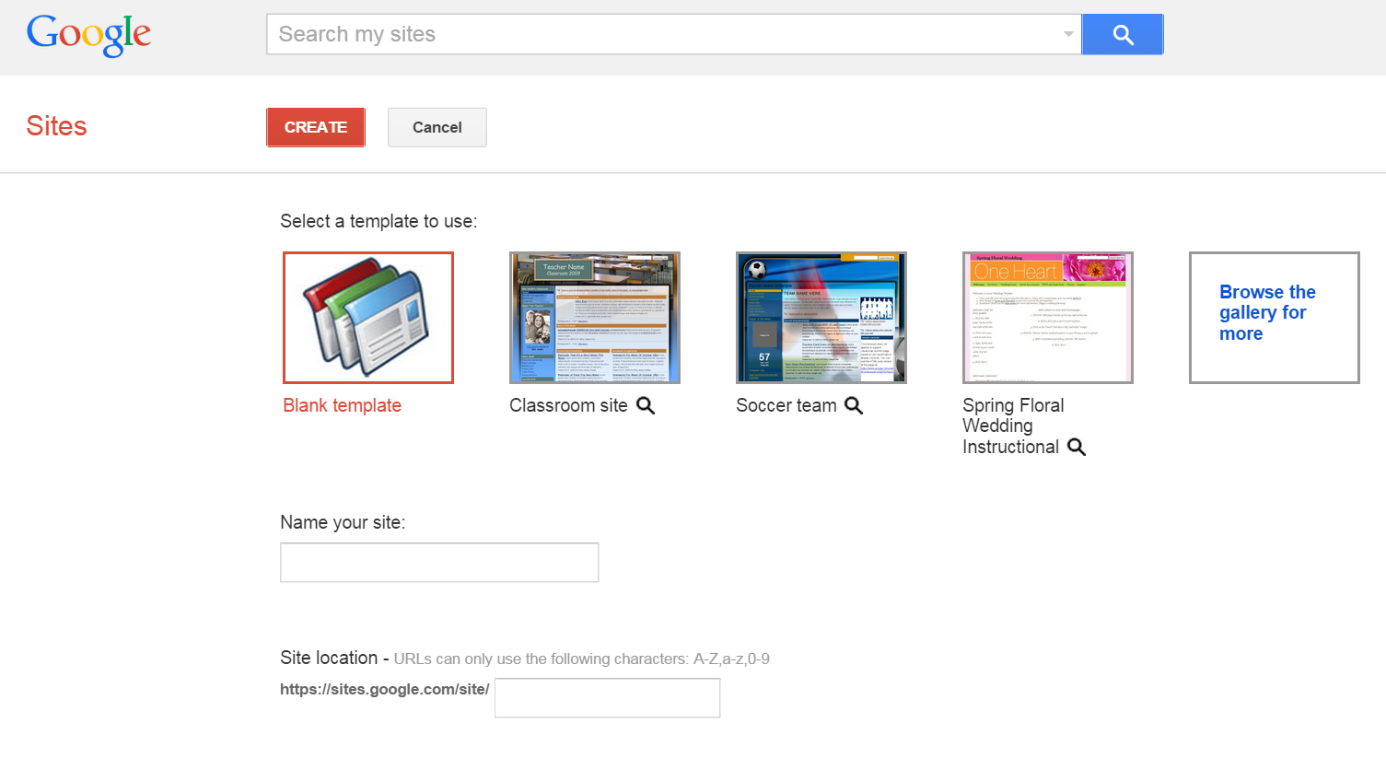
Creating your own website
https://sites.google.com/

Slide 50
Elements to include on your site:
Results (outputs from Google FusionTables)
Interpretation of these results
Conclusions and recommendations based on these results

Slide 51
Day 2: Small group work
Please break up into groups of 3-4 people. Create your website and add results, interpretation and conclusion for Questions 1 and 2 on the Data Key and Indicator List and any other data of interest to you.

Slide 52
Day 3
Present HIV program outputs and strengths and gaps identified
Develop evidence –based, actionable recommendations for the district based on HCT strengths and gaps
Determine next steps and action items

Slide 53
Closing
Please answer the end of workshop evaluation
THANK YOU!

